Slide 1
LaTeX Workshop
Aayush Adhikari
Microsoft Learn Student Ambassador
https://www.linkedin.com/in/aayush518/

Slide 2
Outline
Introduction: What is LaTeX?
Overleaf
Structure of a Document
Basic Commands
Math & Equations
Bibliographies
Tables & Figures (if time allows)

Slide 3
Introduction
LaTeX is a typesetting system that allows you to focus on your content instead of formatting - formatting is done separately from entry.
You tell LaTeX “what it is” not “how it looks.”

Slide 4
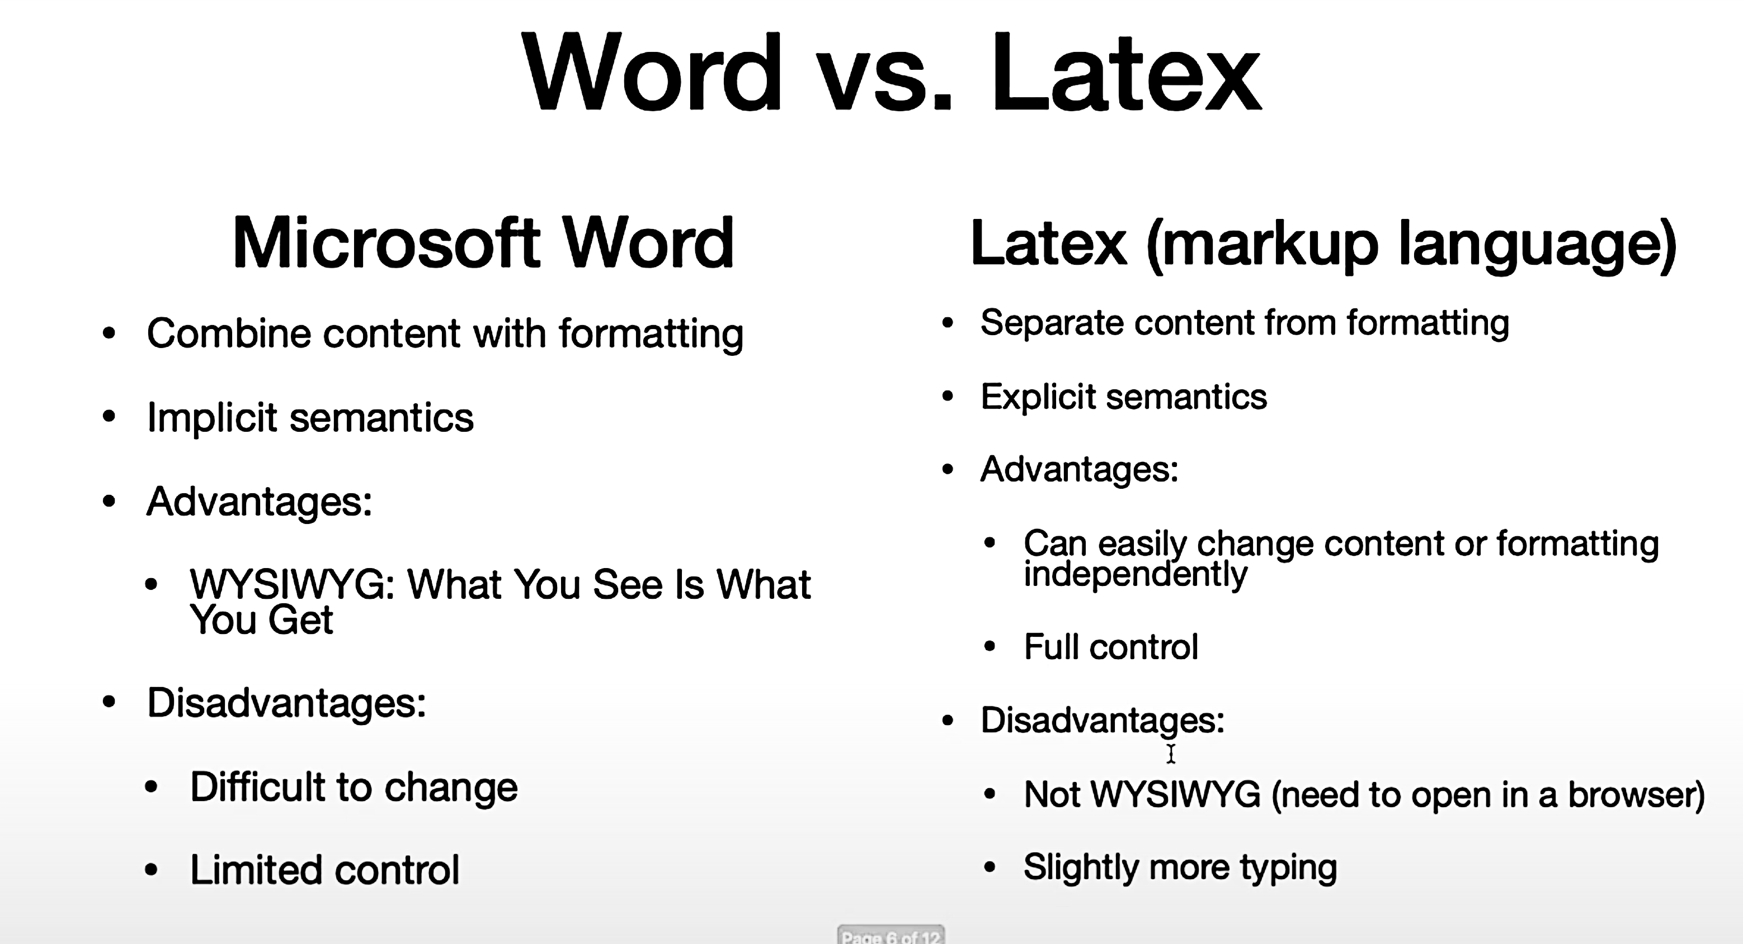

Slide 5
Overleaf for LaTeX
Create documents via a cloud-based account
Source code or rich text format
Collaborating and sharing documents
Versioning and track changes
Templates for a variety of documents and publishers
Link with other tools in your research workﬂow
Solves the problem of installing it locally

Slide 6
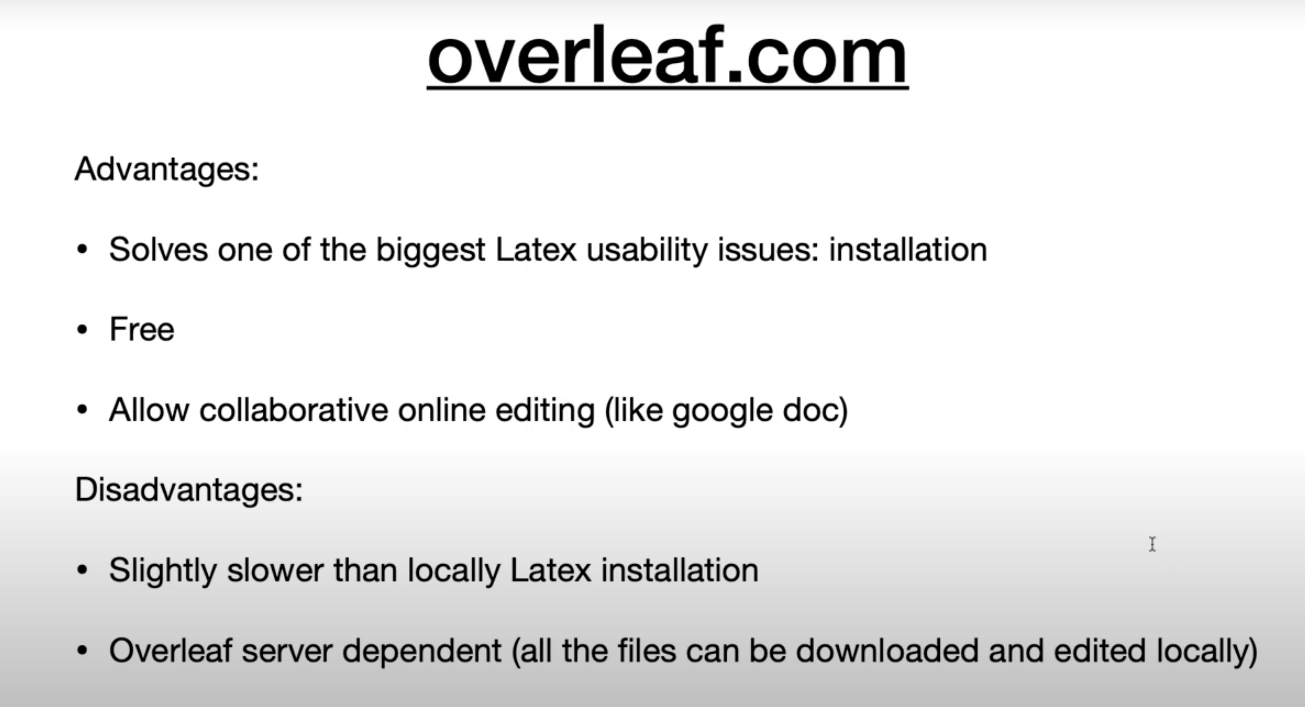

Slide 7
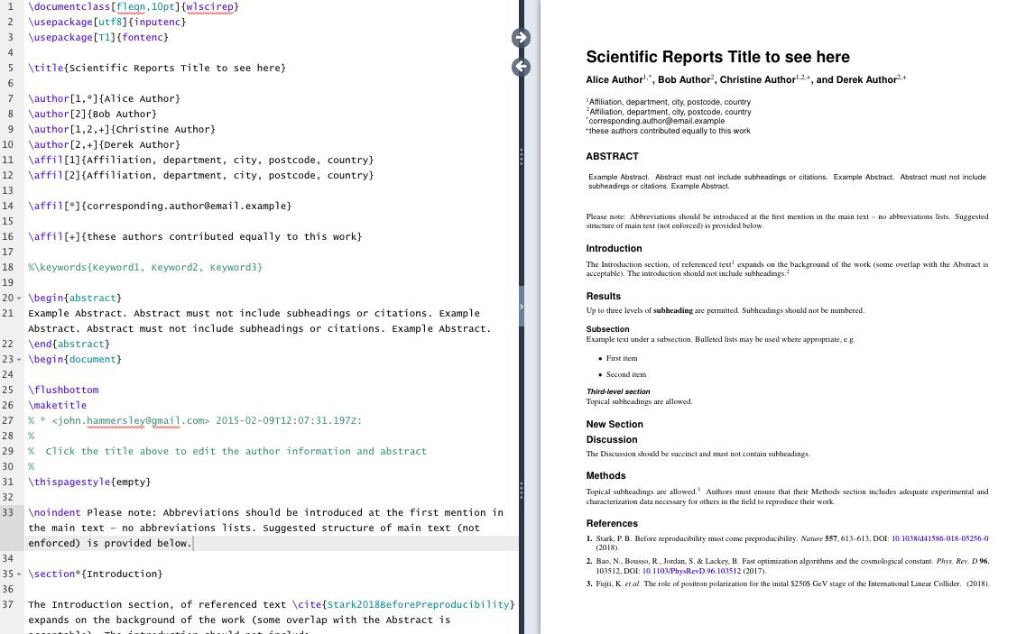

Slide 8
Structure of a Document
Command: a control sequence which performs an action, such as
\newpage
Preamble: block of commands that deﬁne the type of document you are writing, the language you are writing in, the packages you would like to use. Comes before \begin{document}
\documentclass[12pt, letterpaper]{article}
\usepackage{amsmath}
Package:
Packages enable you to do more, like create bibliographies, insert images, and write formulas and ﬁgures.

Slide 9
Structure of a Document
Environment: A block of code with speciﬁc behavior depending on its type. Requires
\begin{}...\end{}
Body: the content of document enclosed inside an environment:
\begin{document}
\end{document}

Slide 10
Note:
Comments:
Use % to create a comment. Nothing on the line after the % will be typeset.
Restricted Characters:
Certain symbols require a backslash to appear, like $, &, #, and %.

Slide 11
Basic Commands
Bold: \textbf{example}
Italics: \textit{example} Underline: \underline{example}
Font typefaces: Change in preamble. More information:
https://v2.overleaf.com/learn/Font_typefaces

Slide 12
Make Title
The simplest option is to use the \maketitle command which draws from the following declarations within the preamble:
\author
\date
\thanks
\title

Slide 13
Basic Math
To display math inline with text, place formula or symbol in between $:
$x + y = z$
Display mode, using \[ x + y = z \]
will center the equation on its own line:
OR
$$x + y = z$$
x + y = z

Slide 14
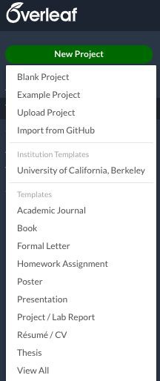
EXERCISE 1
Objective:
Practice several basic LaTeX commands in a new project.

Slide 15
Mathematics & Equations

Slide 16
Operators and More
Operators & Relations: | +, - , = , > , < | work as expected
\times = x | \geq = ≥ | \neq = ≠
\div = ÷ | \leq = ≤ | \pm = ±
Fractions: \frac{1}{x} gives ⅟x

Slide 17
Greek Letters
Examples:
\alpha = 𝛼
\beta = 𝛽
\mu = 𝜇
\pi = 𝜋
\Gamma | = 𝛾 | \rho = | 𝜚
\delta | = 𝛿 | \sigma | = 𝜎
\Delta | = ∆ | \psi = | 𝜓
\lambda = 𝜆
𝛬
\omega = 𝜔
\Lambda =
But A = A (Alpha), B = B (Beta), Z = Z (Zeta), etc.
\Omega = Ω

Slide 18
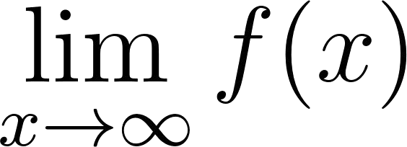
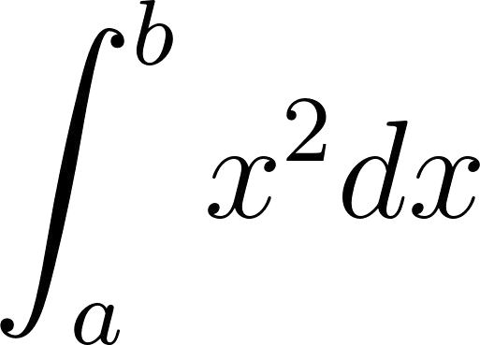
Limits & Integrals
Limit:
\[
\lim_ {x \to \infty} f(x)
\]
Integral:
\[
\int_{a}^{b} x^2 dx
\]

Slide 19
amsmath & amssymb packages
These packages provide you with additional mathematical symbols and commands for structuring equations.
To include, add to your preamble:
\usepackage{amsmath}
\usepackage{amssymb}

Slide 20
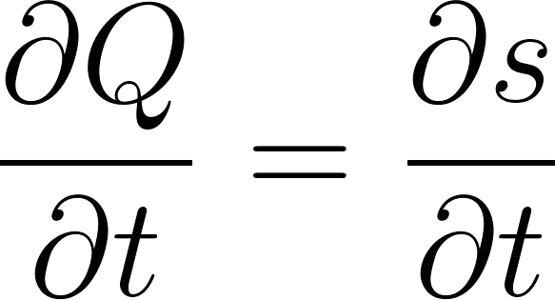
amsmath equation environment
\begin{equation}
\frac{\partial Q}{\partial t} = \frac{\partial s}{\partial t}
\end{equation}
gives
(1)
Note: use {equation*} for unnumbered equations

Slide 21
EXERCISE 2
Objective: Experiment with mathematical notations in LaTeX.

Slide 22
Bibliographies

Slide 23
Bibliographies & Terminology
.bib = ﬁle that stores your references
Package/Backend options:
bibtex
biber
natbib
biblatex
We’ll focus on biblatex today. Learn more about citation and bibliography styles using biblatex:
https://www.overleaf.com/learn/latex/Biblatex_citation_styles

Slide 24

What does a .bib entry look like?
@article{drachen2016sharing,
Key: the syntax used in the cite command to call in an in-text citation
title={Sharing data increases citations},
author={Drachen, Thea and Ellegaard, Ole and Larsen, Asger and Dorch, S{\o}ren}, journal={Liber Quarterly},
volume={26}, number={2}, year={2016}
}

Slide 25
Step 1: Connect your project to a bibliography
Create or upload your own .bib ﬁle
enter a URL
connect your Mendeley or Zotero account with Overleaf

Slide 26
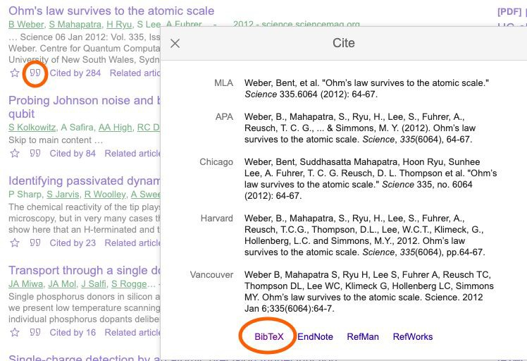
Bibliography Example:
Create new ﬁle within project and name it references.bib
Search for three listed articles in Google Scholar
Paste associated BibTeX entry into references.bib ﬁle

Slide 27
Step 2: Add packages and commands
\usepackage[backend=biber, style=authoryear]{biblatex}
BibLaTeX is one package that processes bibliographic information and helps set the style.
\addbibresource{references. bib}
Calls in .bib ﬁle
…..
Sets bibliography style.
\printbibliography
\nocite{*}
Displays bibliography
Displays entire bibliography, including uncited items

Slide 28
Syntax and Output
\cite{robinson_science_2019}
\citeauthor{jon90}
Robinson et al. (2019)
Textual: ...in Jones et al. (1990)

Slide 29
EXERCISE 3
Objective:
Learn to sync or upload a .bib ﬁle, use basic citation commands, and add a bibliography.

Slide 30
Tables & Figures

Slide 31
Tables
\usepackage{tabularx}
Basic Commands:
l, r, c column alignment
s column alignment for SI units
& ampersand separates columns
\\ double backslash begins new row
\hline horizontal line
| vertical line

Slide 32
Basic Two Column Table
\usepackage{tabularx}
.....
\begin{table}
\begin{tabular}{lc} Item & Qty \\ \hline Widget & 1 \\
Gadget & 2 \\
Cable & 3 \\
\end{tabular}
\end{table}
Item | Qty
Widget | 1
Gadget | 2
Cable | 3

Slide 33
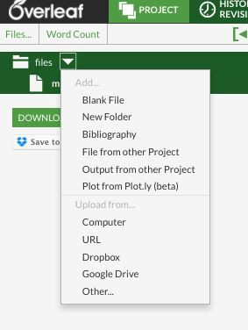
Uploading ﬁgures

Slide 34
Uploading ﬁgures (simplest)
\usepackage{graphicx}
...
\includegraphics[width=0.4\textwidth]{keyboard_cat}

Slide 35
Figure & Table Placement
Specifier | Permission
h | Place the float here: approximately, not exactly, at the same point it occurs in the source text.
t | Position at the top of the page.
b | Position at the bottom of the page.
p | Put on a special page for floats only.
! | Override internal parameters LaTeX uses for determining "good" float positions.
H | Places the float at precisely the location in the LaTeX code. Requires \usepackage{float}. This is somewhat equivalent to h!

Slide 36
EXERCISE 4
Objectives:
Learn the basic commands to create and edit tables. Upload and place a ﬁgure.

Slide 37
Questions?
There’re ChatGPT, CLAUDE, GEMINI and 1000s of LaTeX documentions out there.

